Slide 1

Craig’s Adventure
The Official strategy guide Written by: Anmol

Slide 2
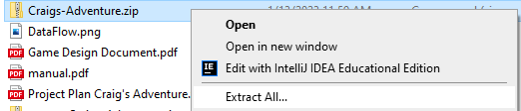
Install Instructions
Extract “Craigs-Adventure.zip”
Open and run the .exe file inside
Enjoy the world of Craig’s Adventure

Slide 3
The story
Long ago the Land of Jauntlet was a free and prosperous land ruled by a lineage of great kings…
For generations they ruled the land with grace and dignity. Prince Skull, the second son, upon hearing he would not become king made a deal with a Witch to turn all his subjects into monsters. In return, he would become powerful far beyond any human’s comprehension.
For years the citizens wandered the hall of the great tower and the surrounding forest in search of a cure but soon all of them lost their minds.

Slide 4

Craig?
He’s a 47-year-old balding American who suddenly found himself in the middle of a mysterious forest
He’s trained himself in the art of the blade in hopes of impressing a girl.
Despite his looks Craig is an extremely agile fighter able to evade most enemy attacks with ease.
Confused, Craig has entered a frenzy due to being transported here.

Slide 5



The Foes
Goblin: These monsters by far got the worst end of the whole curse ordeal, being given a weakened body and a panicked mind. The only thing they have left is their ability to spit rocks.
Slime: they’re completely attention starved. They will run at you relentlessly until killed.
Red Slime: a rare variant of the slime these fellows are quite similar but upon death they explode into projectiles.

Slide 6


Skeleton: a creature most unloved. God may have given them 206 bones, but they never can make use of them all.
Wizard: they formerly held positions of great power. The one Foe to not have lost their mind. Able to spawn an explosion below the player, these dastardly dudes disappear from one destination to another.

Slide 7

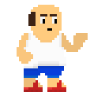

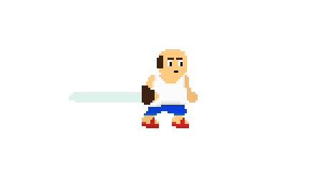
Controls
W
A
D
S
Pick up an item/ throw the item
F =
These Controls are for when you're using a mouse and keyboard
Space Bar to Dash
Left Mouse Click
Esc = Pause menu
Tab = Map
= Attack!

Slide 8
Left joystick for movement
These Controls are for when you're using a controller
L
Pick up an item/ throw = the item
Shoulder buttons
X or Y to Dash! (north and east buttons)
A or B buttons (south and west buttons)
Attack! =
Plus (switch controller)
Start (xbox)
Pause/Options (playstation)
Pause Menu =

